Slide 1
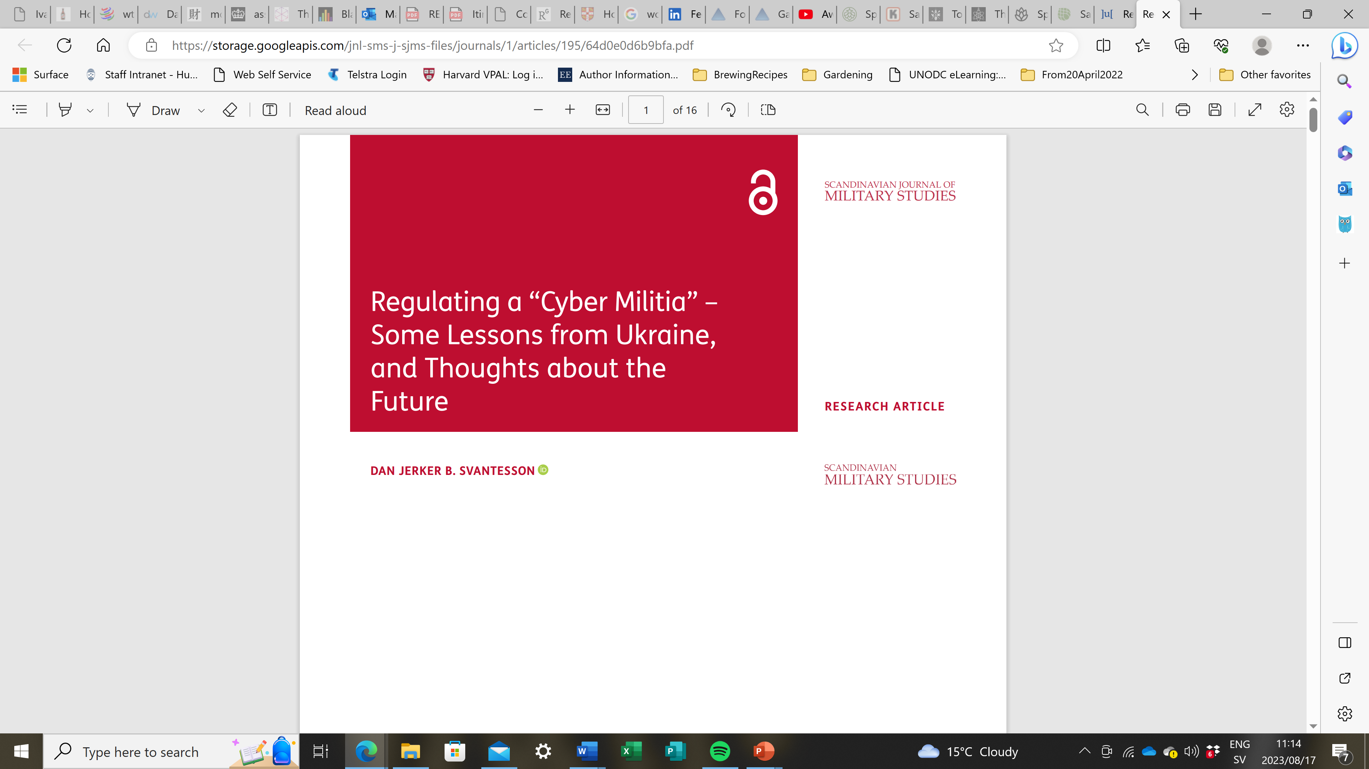

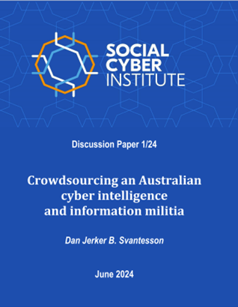
Is Australia prepared to defeat information warfare? The role(s) of an Australian cyber intelligence and information militia
https://sjms.nu/articles/10.31374/sjms.195 (free download)
https://www.socialcyber.co/_files/ugd/15144d_5ac4372572ec4b2e99421538e62778cc.pdf (free download)
Professor Dan Jerker B. Svantesson - Bond University

Slide 2
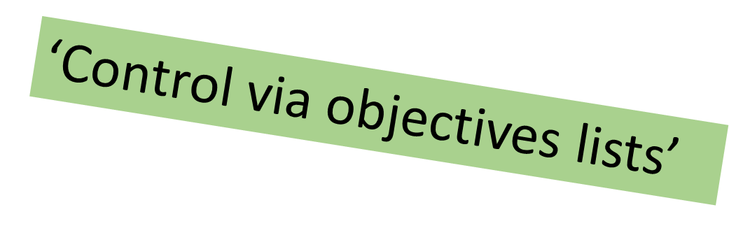
Five possible roles for a ‘cyber militia’
Cyber security (systems support);
“Cyber attacks”;
Espionage;
Open-source intelligence; and
Information conflict (‘information warfare’).
Professor Dan Jerker B. Svantesson - Bond University

Slide 3
Criteria for suitable
‘cyber militia’ tasks
Low risk;
Low/no sensitivity;
Limited complexity;
Labour intensive;
Under threshold for “Civilians directly participating in hostilities”; and
Where people are better than bots/tech.
Professor Dan Jerker B. Svantesson - Bond University

Slide 4
Open-source intelligence
“OSINT is vital to the Intelligence Community’s Mission. OSINT both enables other intelligence collection disciplines and delivers unique intelligence value of its own, allowing the IC to more efficiently and effectively leverage its exquisite collection capabilities. As the open source environment continues to expand and evolve at breakneck speed, the ability to extract actionable insights from vast amounts of open source data will only increase in importance.” (United States Intelligence Community OSINT Strategy 2024-2026 (2024), at 2)
Professor Dan Jerker B. Svantesson - Bond University

Slide 5
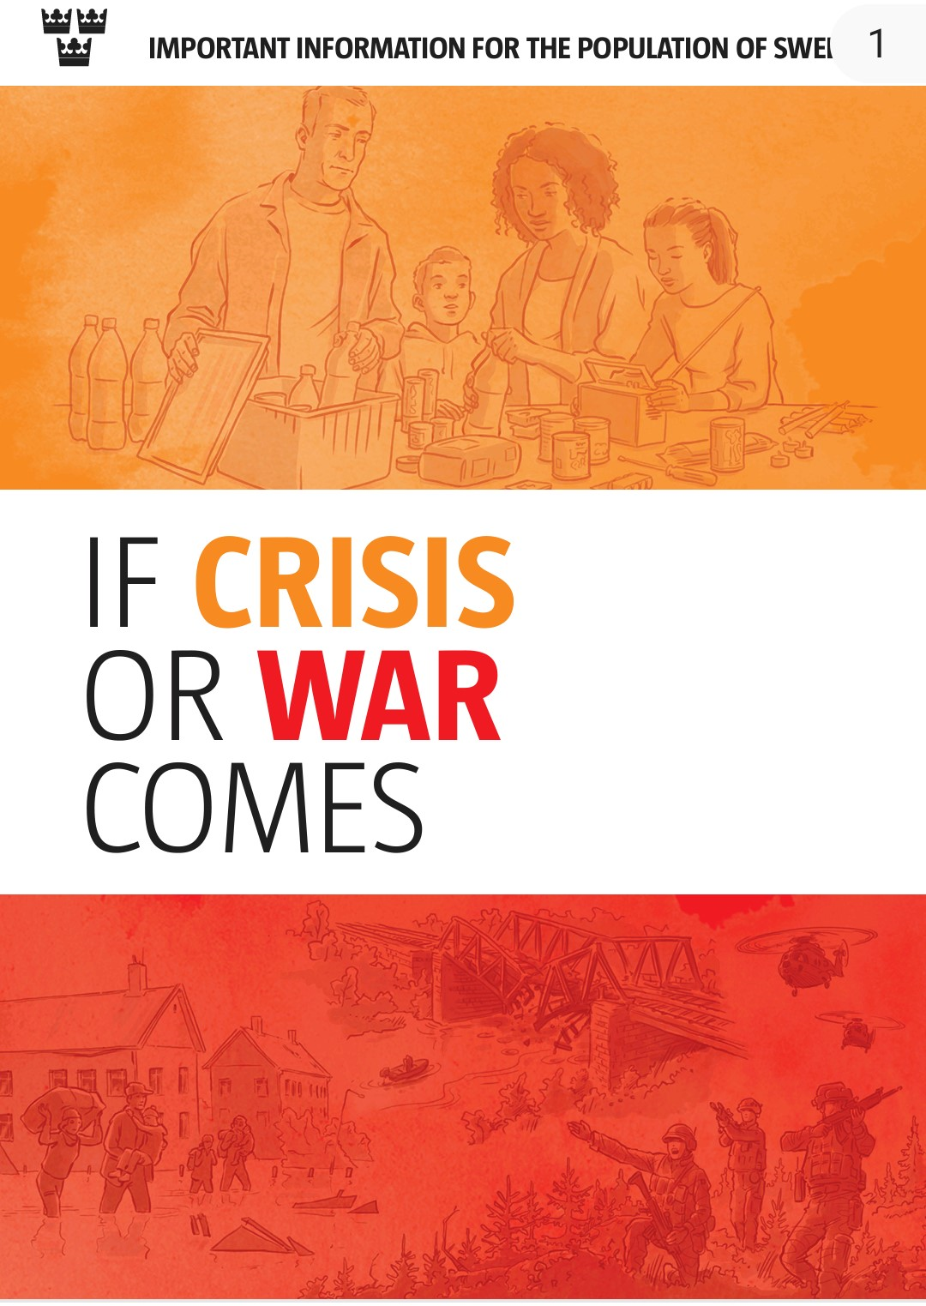
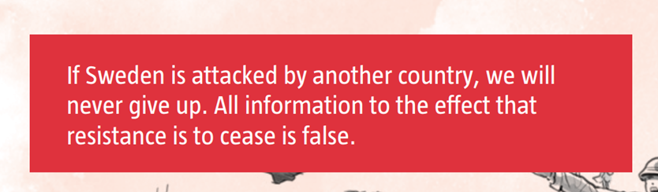
Information conflict (‘information warfare’)
“Social media and other internet platforms are used to spread false rumours; disinformation, conspiracy theories, and racist and anti-Semitic message. These affect opinion formation, interpersonal trust, democratic discourse, the community and thus the national security. ”
“Civil society plays an important role in Sweden’s ‘total defence’ capability and contribute to building the social cohesion and trust that are the basis of the willingness to defend ourselves.”
(Swedish Nationell säkerhetsstrategi 2023/24:163 (Juli 2024), at 11 & 8)
Professor Dan Jerker B. Svantesson - Bond University

Slide 6
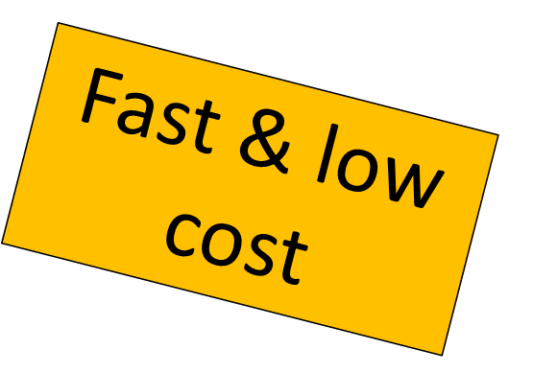
What is a ‘cyber militia’?
“A cyber militia undertakes defense-related activities (broadly defined) in or pertaining to cyberspace on behalf of a state, with that state’s formal recognition, and with some degree of coordination or guidance on behalf of that state but does so outside the ambit of that state’s regular armed forces or national security structure. Cyber militias can be ad-hoc, gathering only for a specific occasion, or standing – and there is nothing to prevent the participants from receiving compensation or support, either financial or in the form of training, from the state in question.”
Professor Dan Jerker B. Svantesson - Bond University

Slide 7
A ‘cyber militia’ is not:
Traditional (criminal) non-state actor;
Cyber vigilantes;
Journalists;
Private sector actors;
Military and national security branches;
Conscripted “cyber warriors”; or
“Cyber home guard”.
Professor Dan Jerker B. Svantesson - Bond University

Slide 8
Some advantages of formally recognising a ‘cyber militia’:
Already happening, so we need to do something;
Enhance efficiency;
Transparency and accountability;
Clarity and appropriate legal safeguards;
(ICT-literacy);
‘Totalförsvar mentality’;
Recruitment tool; and
Deterrence (preserving peace).
“States must not use proxies to commit internationally wrongful acts using ICTs (information and communications technology), and should seek to ensure that their territory is not used by non-State actors to commit such acts.” (A/76/135)
Professor Dan Jerker B. Svantesson - Bond University

Slide 9
Key risks and legal complications:
Some key risks: | Some key legal complications:
Loss of control | Due diligence
Escalation risk | Use of force
Infiltration | Sovereignty
Abuse | Coercive means intervening in the internal or external affairs of other States
Structural issues (e.g., oversight) | Principle of distinction
Risk to individual members | Proportionality
Undermine private sector capacity | Necessity
Organisational complexity / activity overlap | Legal safeguards for militia members
Professor Dan Jerker B. Svantesson - Bond University

Slide 10
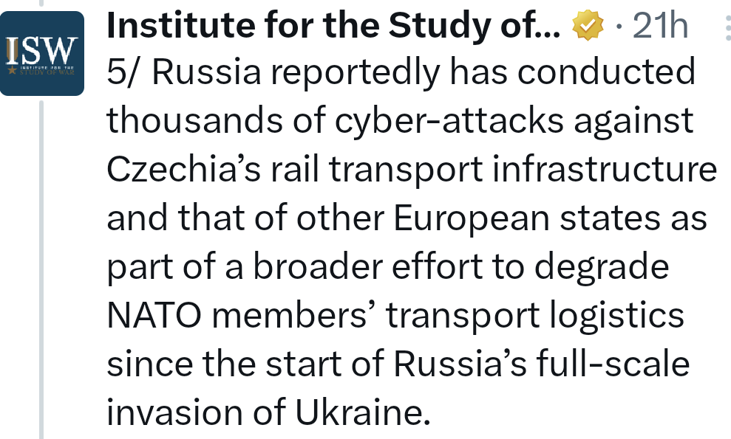
29 July 2022 Annual Progress Report by the Open-Ended Working Group on security of and in the use of information and communications technologies 2021-2025 (OEWG):
“the use of ICTs in future conflicts between States is becoming more likely”
Professor Dan Jerker B. Svantesson - Bond University

Slide 11
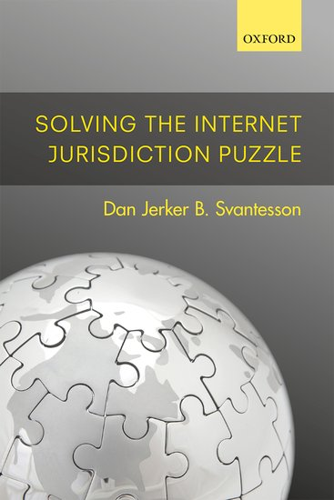
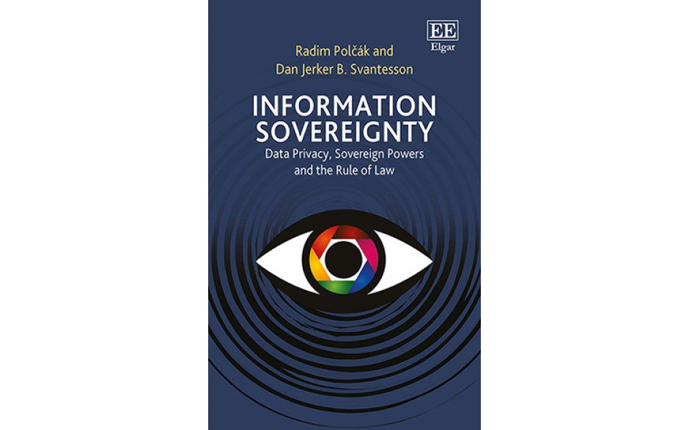
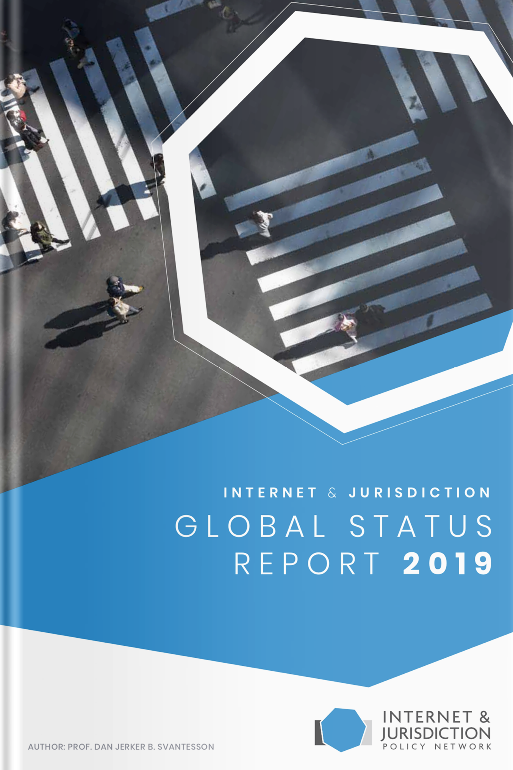
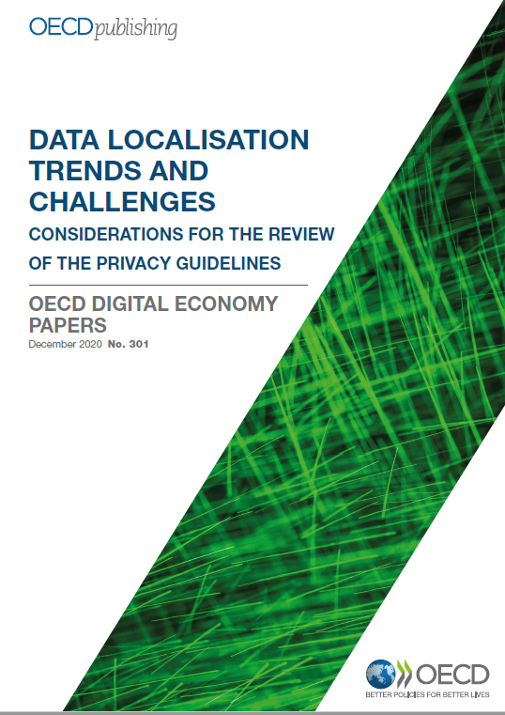
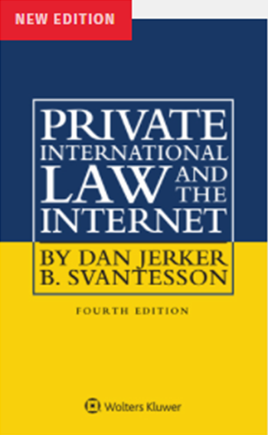
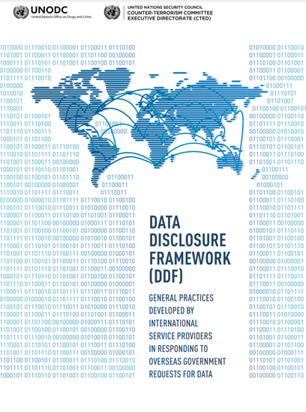
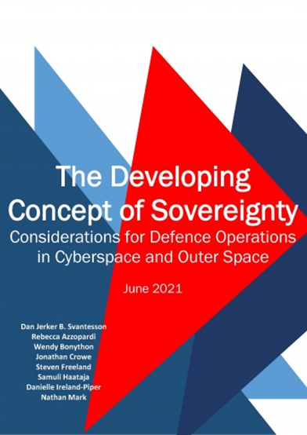
Thank you!
Dan Svantesson
dasvante@bond.edu.au
WARNING:
Self-promotion
Professor Dan Jerker B. Svantesson - Bond University

